Slide 1
Test Mockups/Scenarios
Stove & Oven Web Application

Slide 2
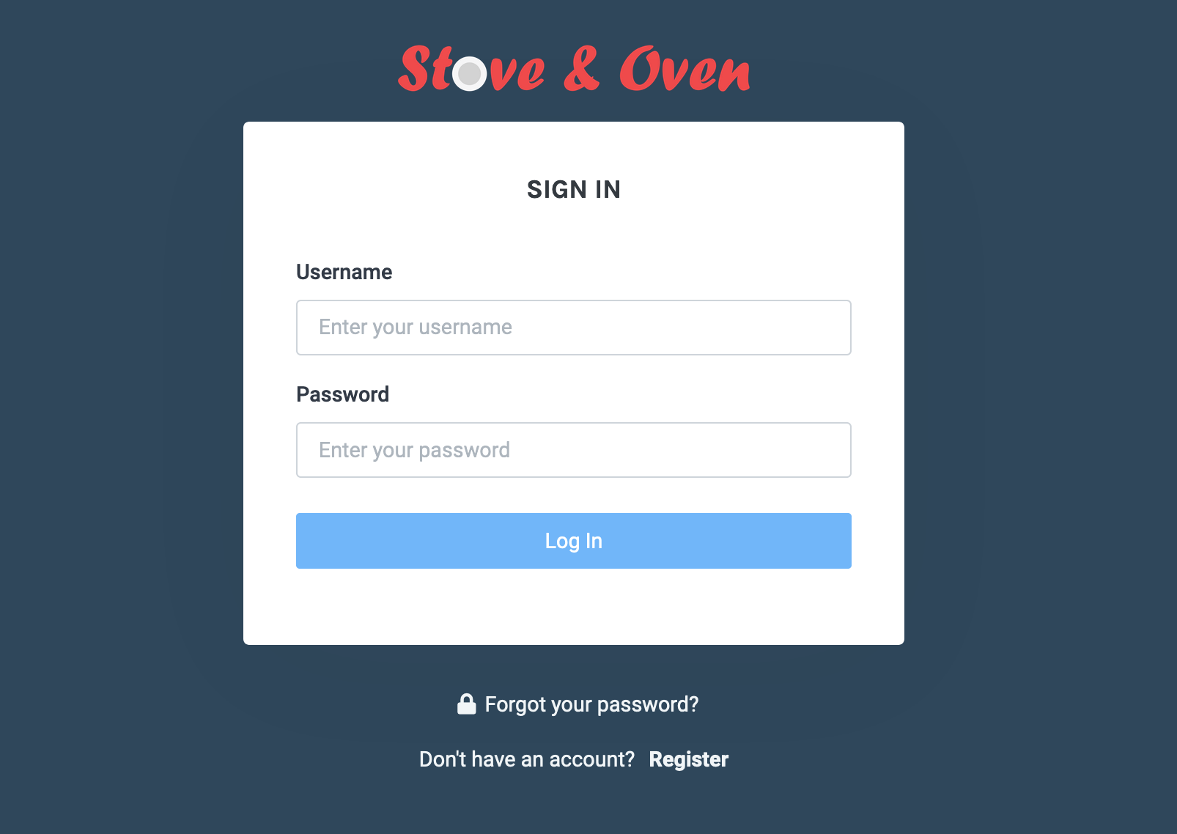
Login

Slide 3
Default Dashboard / User’s Refrigerator

Slide 4
My Recipes

Slide 5
Planner-1

Slide 6
Planner-2

Slide 7
Planner-3

